Slide 1
MLDS HW3-2
TAs
ntu.mldsta@gmail.com

Slide 2
Update
5/15: 更新Baseline Model

Slide 3
Baseline Model (5/15 Update)
Generator
noise_input = (100,);
text_input = (119,);
# num of (hair, eyes) pairs
text_emb = Dense(256,‘relu’)(text_input);
concatenate([noise_input, text_emb]);
Dense(4*4*512); Reshape((4, 4, 512));
Batchnorm(mom=0.9); Relu;
Conv2DTranspose(256, kernel=5);
Batchnorm(mom=0.9); Relu;
Conv2DTranspose(128, kernel=5);
Batchnorm(mom=0.9); Relu;
Conv2DTranspose(64, kernel=5);
Batchnorm(mom=0.9); Relu;
Conv2DTranspose(3, kernel=5);
Tanh;
Discriminator
image_input = (64,64,3);
text_input = (119,);
text_emb = Dense(256,’relu’)(text_input);
text_emb = Reshape((1,1,256))(text_emb);
tiled_emb = tile(text_emb, [1,4,4,1]);
Conv2D(64 ,kernel=5)(image_input); LeakyRelu;
Conv2D(128, kernel=5);
Batchnorm(mom=0.9); LeakyRelu;
Conv2D(256, kernel=5);
Batchnorm(mom=0.9); LeakyReLu;
Conv2D(512, kernel=5);
Batchnorm(mom=0.9);
image_feat = LeakyRelu;
concatenate([image_feat, tiled_emb]);
Conv2D(512, kernel=1, strides=(1,1));
Flatten;
Dense(1, ‘sigmoid’);
Training
Adam(lr = 0.0002, beta = 0.5)

Slide 4
Outline
Timeline
Task Descriptions
Model & Training tips
Submission & Rules
Q&A

Slide 5
Timeline

Slide 6
Three Parts in HW3
(3-1) Image Generation
(3-2) Text-to-Image Generation
(3-3) Style Transfer

Slide 7
Schedule
5/4 :
Release HW3-1
5/11 :
Release HW3-2
5/18:
Release HW3-3
6/8:
All HW3 due (including HW3-1, HW3-2, HW3-3)
上台分享

Slide 8
Task Descriptions

Slide 9
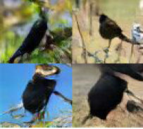
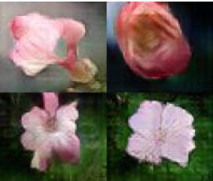
HW3-2: Text-to-Image Generation 1/2
Bird
Generative Model
an all black bird
this flower is
white and pink
Flower Generative Model

Slide 10


HW3-2: Text-to-Image Generation 2/2
a man with no hair
and one red strong fist
Anime Generative Model
a girl with blue hair, blue eyes and
twin ponytail

Slide 11
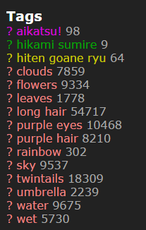
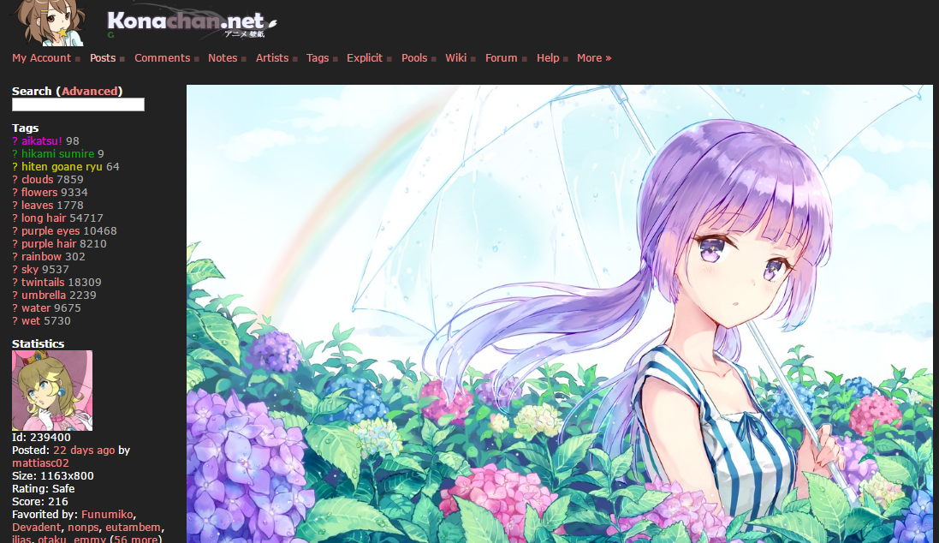
Data Collections 1/2
Anime dataset
http://konachan.net/post/show/239400/aikatsu-clouds-flowers-hikami_sumire-hiten_goane_r
感謝樊恩宇助教蒐集data

Slide 12
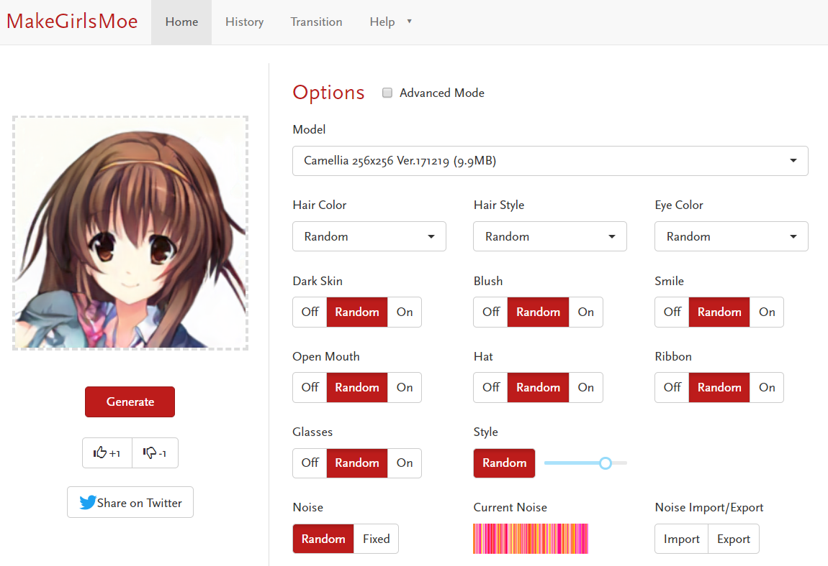
Data Collections 2/2
Extra data
https://make.girls.moe/#/
感謝吳宗翰同學收集並處理資料

Slide 13
Model & Training Tips

Slide 14
Conditional GAN
Overview
real images
Discriminator
condition
noise
fake
images
condition
Generator
condition

Slide 15
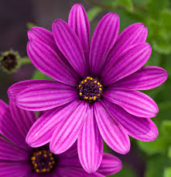
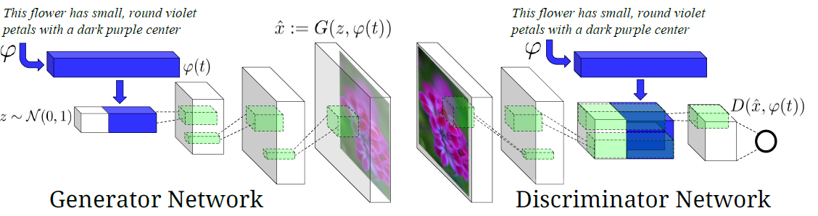
Conditional GAN for Text-to-Image Generation 1/2
real img
(noise_dim+text_dim)
(4, 4, channel_dim+text_dim)
fake img
ref: https://arxiv.org/pdf/1605.05396.pdf

Slide 16
Conditional GAN for Text-to-Image Generation 2/2
real img
‘purple flowers’
0 0 0 0 0 1 0 0
text
‘purple flowers’
0 0 0 0 0 1 0 0
text
NN
NN
(noise_dim+text_dim)
(4, 4, channel_dim+text_dim)
fake img
ref: https://arxiv.org/pdf/1605.05396.pdf

Slide 17
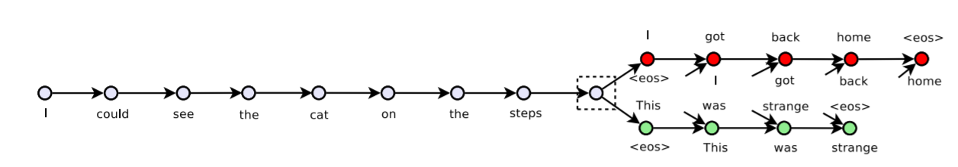
Text Feature Process Tool - Skip-thought Vector
Pretrained embedding
skip-thought source code: https://github.com/tensorflow/models/tree/master/research/skip_thoughts#download-pretrained-models-optional
No matter which tool you use to process text input, please make sure you include that pre-trained model in your repository to let us run your code successfully.

Slide 18
Tip for Training
Discriminator Output:
(real image, right text): 1
(fake image, right text): 0
(wrong image, right text): 0
Different objective function
Wasserstein GAN (WGAN)
Improved WGAN (WGAN-GP)
Auxiliary Classifier GAN (ACGAN)
StackGAN

Slide 19
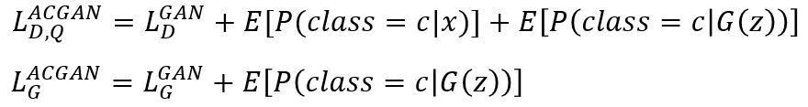
ACGAN 1/2
Discriminator should also be able to do a classification task.

Slide 20
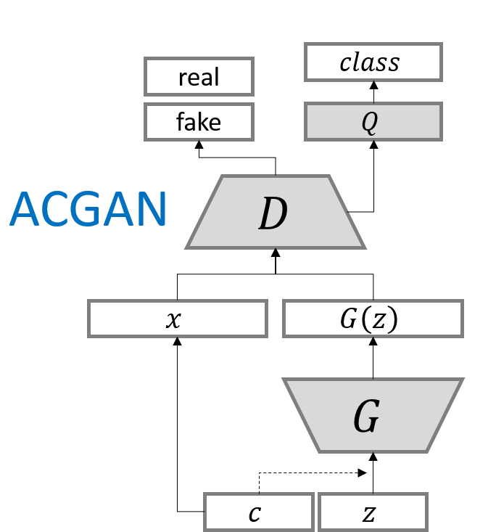
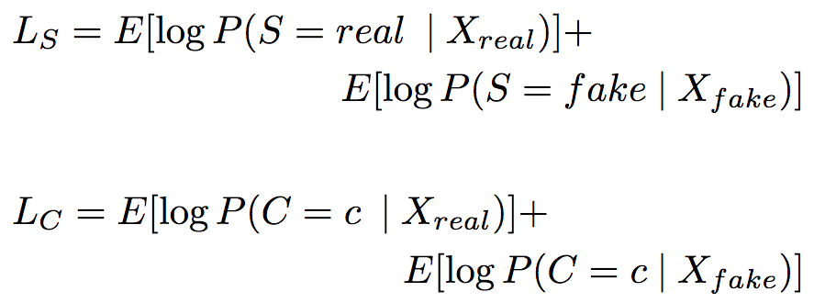
ACGAN 2/2
D is trained to maximize L_{s} + L_{c}
while G is trained to maximize L_{c} - L_{s}
ref:https://arxiv.org/pdf/1610.09585.pdf

Slide 21
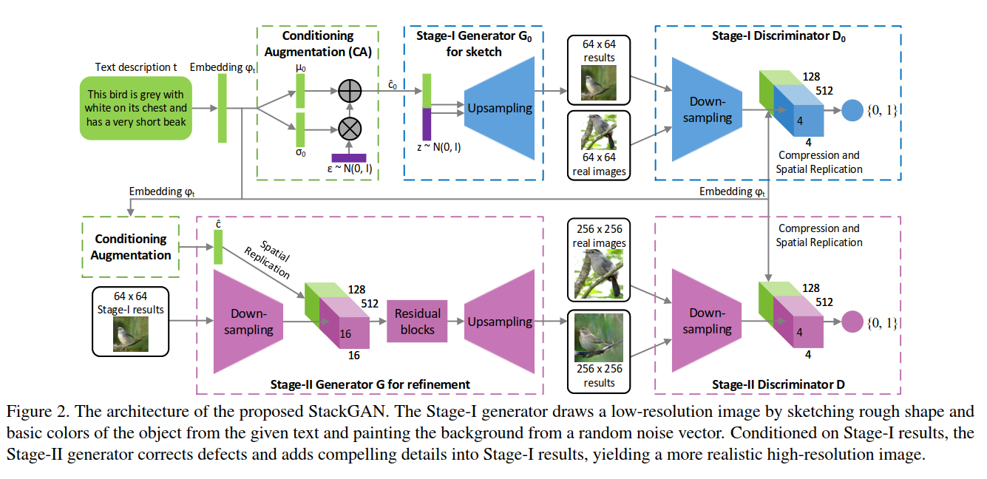
StackGAN
ref:https://arxiv.org/pdf/1612.03242.pdf

Slide 22
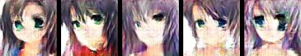
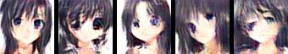
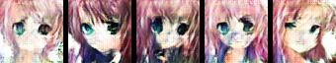
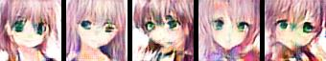
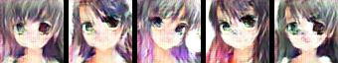
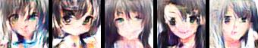
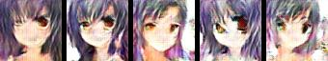
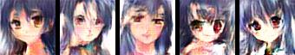
Little Results
input text: black hair blue eyes
input text: black hair blue eyes
input text: pink hair green eyes
input text: pink hair green eyes
input text: green hair green eyes
input text: green hair green eyes
input text: blue hair red eyes
input text: blue hair red eyes
GAN result
WGAN-GP result

Slide 23
Submission & Grading

Slide 24

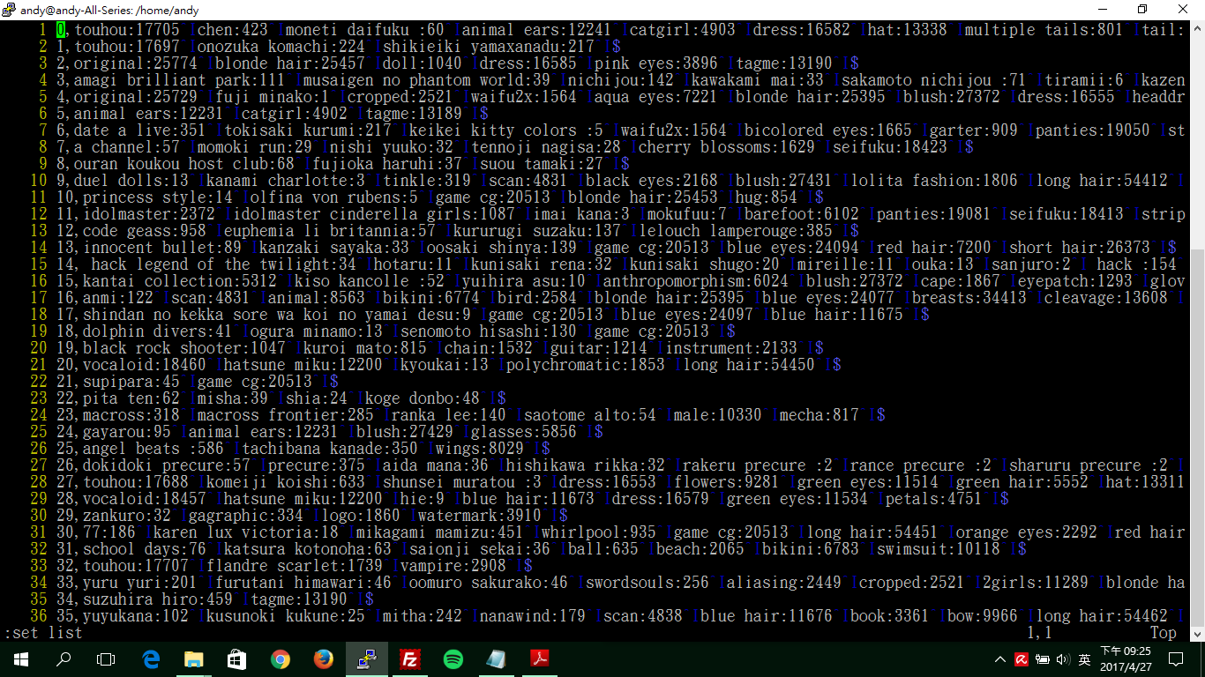
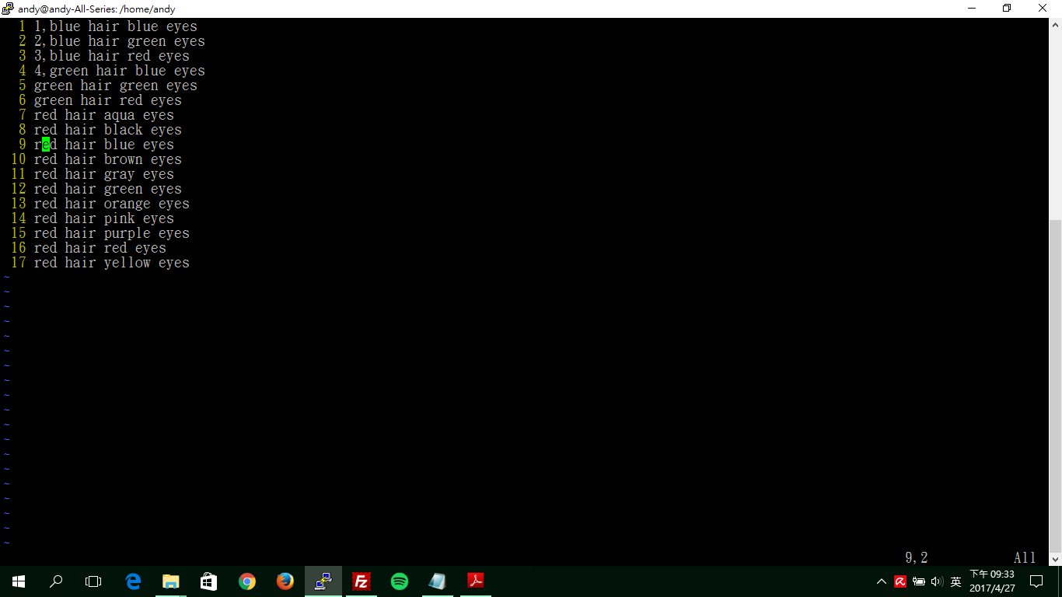
Data & format
Anime Dataset
training data: 33.4k (image, tags) pair
faces/, tags.csv, testing_tags.txt
training tags file format
img_id <comma> tag1 <colon> #_post <tab> tag2 <colon> #_post
testing text file format
testing_text_id <comma> testing_text
testing text only includes ‘color hair’ and ‘color eyes’, only alphabetic char involved.
blue eyes
red hair
short hair
tags.csv

Slide 25
Testing Text Content
‘color hair’
'orange hair', 'white hair', 'aqua hair', 'gray hair', 'green hair', 'red hair', 'purple hair', 'pink hair', 'blue hair', 'black hair', 'brown hair', 'blonde hair'.
‘color eyes’
'gray eyes', 'black eyes', 'orange eyes', 'pink eyes', 'yellow eyes', 'aqua eyes', 'purple eyes', 'green eyes', 'brown eyes', 'red eyes', 'blue eyes'.

Slide 26

Data & format
Extra data
training data: 36.7k (image, tags) pair
images/, tags.csv
training tags file format
img_id <comma> hair tag <space> eyes tag
tags in extra data only includes ‘color hair’ and ‘color eyes’
black eyes
red hair
tags.csv

Slide 27
All Testing Tags Content
‘color hair’
'orange hair', 'white hair', 'aqua hair', 'gray hair', 'green hair', 'red hair', 'purple hair', 'pink hair', 'blue hair', 'black hair', 'brown hair', 'blonde hair'.
‘color eyes’
'black eyes', 'orange eyes', 'pink eyes', 'yellow eyes', 'aqua eyes', 'purple eyes', 'green eyes', 'brown eyes', 'red eyes', 'blue eyes'.
no 'gray eyes' in extra data

Slide 28
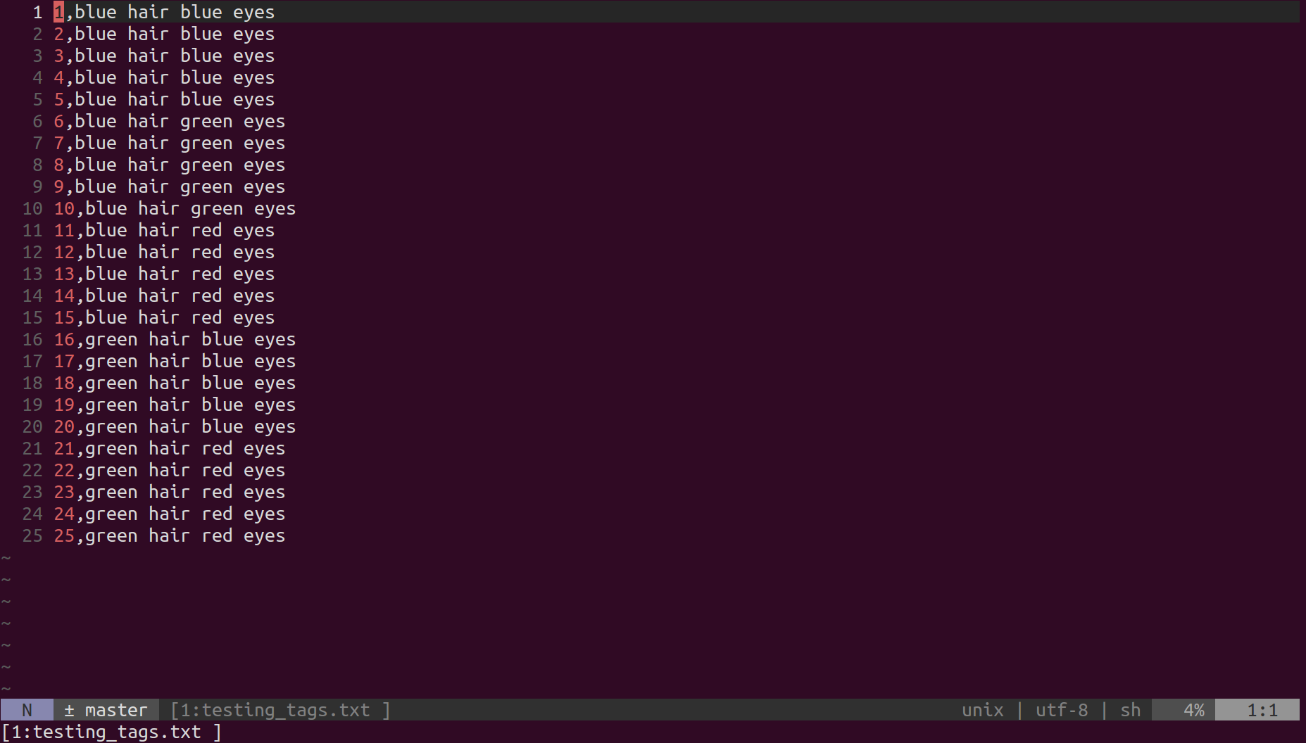
testing_tags.txt

Slide 29
Data Link
Anime Dataset
Extra Data

Slide 30
HW3 Grading Policy:
HW3-1 Code (image generation) : 5%
HW3-2 Code (text-to-image generation): 5%
Report : 15%
HW3-3 (Bonus, style transfer): 2%
分工表：0.5%
上台分享 : 1%
上台分享前三名：1%

Slide 31
HW3-2 Code Grading
Reproduce Score : 2%
Baseline Scroe : 1%
TA Review : 2% (mode collapse,tags)

Slide 32
Output Format Requirement
The generated images should be in Directory samples/
請大家繳交時就將產生的結果傳到samples/，助教利用script reproduce時也請同學將結果輸出到這個資料夾。為保證reproduce結果相同，請同學將random的部份固定
批改作業會在azure上，請同學繳交前在機台上檢查
已經在github裡的image -> samples/cgan_original.png
run_cgan.sh -> samples/cgan.png
Each generated image must be resized to 64 x 64
Generate 25 image into one png
sample code is in baseline.py
為防止同學產生的圖片不一致，請同學使用baseline.py裡的save_imgs()

Slide 33
Submission
Deadline: 2018/06/08 GMT+8 24:00
hw3/ should contain the following files:
run_gan.sh (hw3-1)
run_cgan.sh (hw3-2)
extra_run.sh (hw3-3, bonus)
samples/, samples/gan_original.png, samples/cgan_original.png
report.pdf
pre-trained model, python code...
If some files are too big, upload to your cloud and download them when running your run.sh
TAs will run your scripts in the following order to generate images
bash run_gan.sh (hw3-1)
bash run_cgan.sh <testing_tags.txt> (hw3-2)
All scripts must output in 10 minutes.
shell script裡面請寫相對路徑
HW3-3格式會在之後釋出

Slide 34
Q&A
ntu.mldsta@gmail.com

